Slide 1
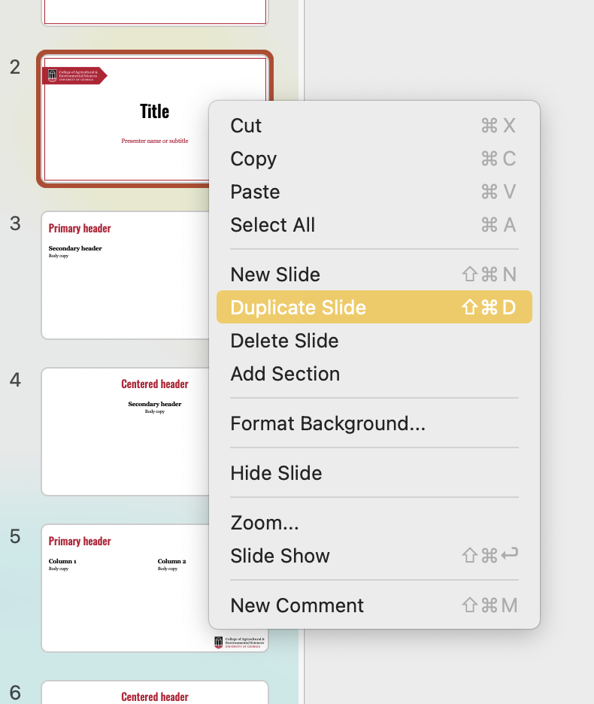
Please delete this slide before using this template.
When creating new slides, we recommend using the “Duplicate Slide” function.
Choose the slide you wish to use, right-click and select "Duplicate Slide.” This method preserves the layout, font and color selections of the template.
If you have any issues using this template, please reach out to caesomc@uga.edu.

